Slide 1
Sign Language Translator
Ksandros apostoli
December 13, 2017
Senior project defense COS 491

Slide 2
Presentation Overview
Purpose and Scope of the project
Requirements
Technologies Applied
Software Design and Machine Learning
Implementation
Results
Demonstration

Slide 3
Purpose and Scope of the “Sign Language Translator”
Project Objective: Build a reliable technology for the digital translation of sign language gestures.
Personal Purpose: Study and observation of the potential use of machine learning methods in the implementation of technologies that promote a better life quality .
Project Scope: Research of ML Classifiers & Image Processing ;
Understanding and Application of these technologies through implementation.

Slide 4
Few Requirements
Functional
At launch user is presented to a menu that allows him/her to choose between “Training” or “Testing” the translator.
The user can capture a sample by pressing “C”
Any time a sample is stored, the user is to be notified about this activity and to be shown the name of the sample stored
If an object is detected on the marked area for detection, the user must be indicated by a text on the top-left of the window, showing “Hand Presence: True”, or otherwise if no object has entered the area “Hand Presence: False”
If the user places his hand in the marked area with a valid gesture, the corresponding translation is to be shown under the video frame
The user can clear this output are using a “Clear” button
Non-Functional
Reliability:
The application must predict correct labels for the trained gestures at a success rate of 90%.
A wait period of 1-2 seconds is applied between two predictions, so no random predictions occur when switching handshape from one gesture to another.
The same letter cannot be predicted two times consecutively without removing the hand from the testing area first.
Performance:
With 5 classes of gestures, and at most 128 samples for each pair of classes, training must take up to 10 seconds to complete, storing the SVM model onto a file.
Trained gestures must not take more than 3-4 seconds to be translated.
Operating Constraints:
Shiny / Overcrowded Background Surfaces behind user must be avoided.

Slide 5
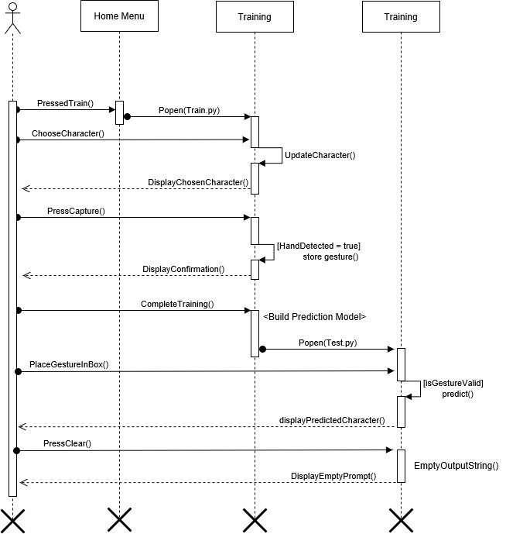

Slide 6
Applied Technologies
NumPy
CVXOPT
SYS, OS
SVM
NumPy
OpenCV
PIL
HOG
Python 2.7 in conjunction with the following packages:
NumPy
OpenCV
CVXOPT
Tkinter
PIL, SYS, OS etc.
OpenCV
Tkinter
User Interface

Slide 7
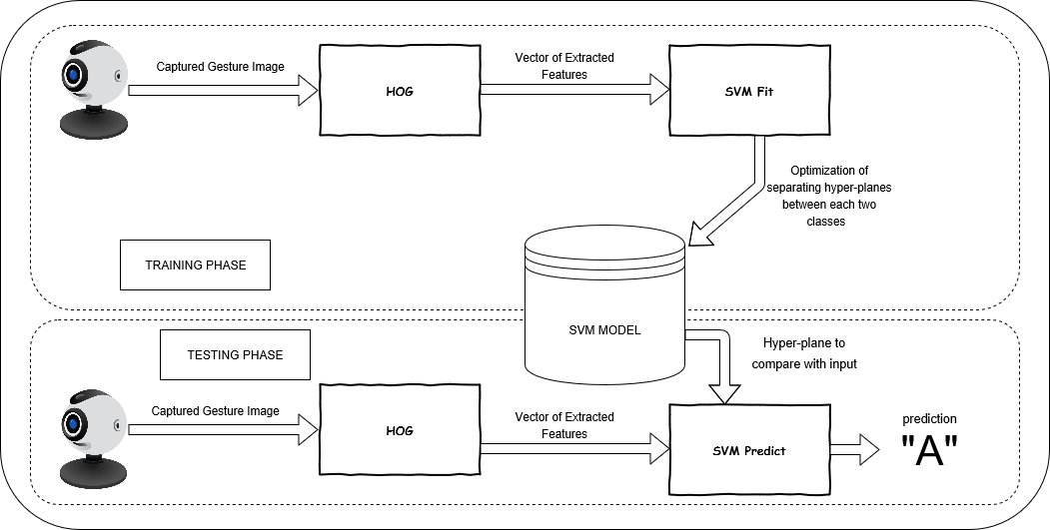
Software Design & Architecture
- Component Based Architecture

Slide 8
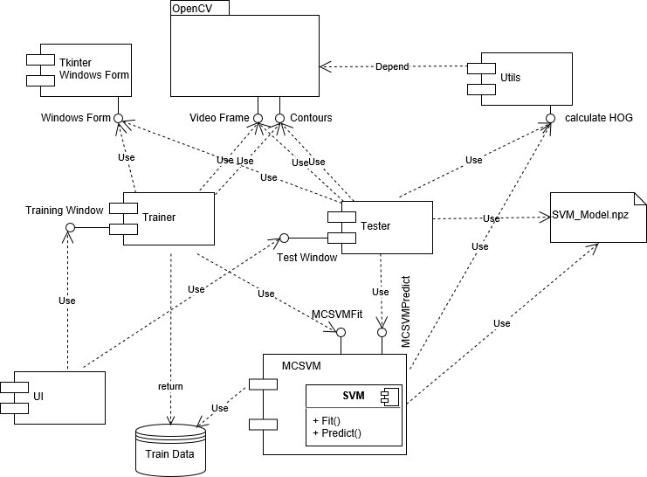

Slide 9
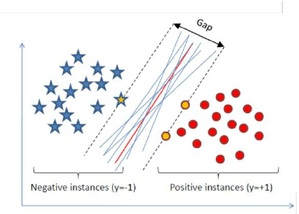

Support Vector Machine | Machine Learning Classification
In order to Predict gestures, we need to somehow “teach” the application to classify such gestures into different classes representing letters.
Let the separating line be:
$$ax+by+c=0$$
Then, for any blue point $\left(x_{1},y_{1}\right)$:
$$ax_{1}+by_{1}+c>0$$
While for any red point $\left(x_{2},y_{2}\right)$:
$$ax_{2}+by_{2}+c<0$$
We can classify any point like this then!

Slide 10
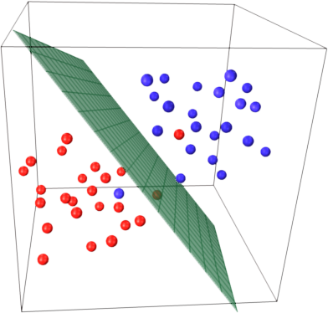
Same Principle for 3 Dimensions| Same for N - Dimensions

Slide 11
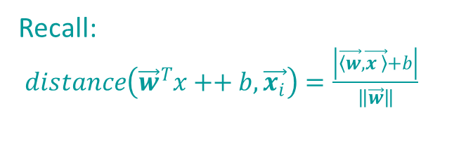

Finding the Optimal Hyperplane | Training the SVM
We need to maximize the distance between Hyperplane and all points
➔ Maximize the gape between points closer to Hyperplane
Margins for this gap, are hyperplanes parallel to the optimal hyperplane
The equations of these hyperplanes change from the optimal by the shift
These equations are:
$$W_{0}:w^{T}x+b=1$$
$$W_{1}:w^{T}x + b = −1$$
And the distance between them, that we want to maximize:
$$\frac{2}{\left\|w\right\|}$$
Recall:
$distance\left(\vec{w}{}_{ }^{T}{x+}+b,\vec{x_{i}}\right)=\frac{\left|\vec{\left\langle w\right.},\vec{\left.x \right\rangle }+b\right|}{\left\|\vec{w}\right\|}$

Slide 12


Lagrange Optimization| Finding the Hyperplane
Now our problem of finding the optimal hyperplane is reduced to maximization:
max $\frac{2}{\left\|w\right\|}$, equivalently : min $\frac{1}{2}\left\| w^{2}\right\|$
But we also need no points lying between the two margins, which results in the following constraints:
$$w^{T}x_{i}+b ≥+1 if y_{i}=+1$$
$w^{T}x_{i}+b≤−1 if y_{i}=−1$
We can combine the two conditions of this inequality to get a new condition:
$$y_{i}\left(w^{T}x\right)≥1$$
This is a constrained optimization problem we now how to solve using Lagrange Multipliers!
Our hyperplane will then be ready!

Slide 13
Histogram of Oriented Gradients | Feeding the SVM
Responsible for converting hand frames into 1-dimensional arrays describing those frames
Algorithmically:
Divide the image into small connected regions called cells, and for each cell compute a histogram of gradient directions or edge orientations for the pixels within the cell.
Discretize each cell into angular bins according to the gradient orientation.
Each cell's pixel contributes weighted gradient to its corresponding angular bin.
Groups of adjacent cells are considered as spatial regions called blocks. The grouping of cells into a block is the basis for grouping and normalization of histograms.
Normalized group of histograms represents the block histogram. The set of these block histograms represents the descriptor.

Slide 14
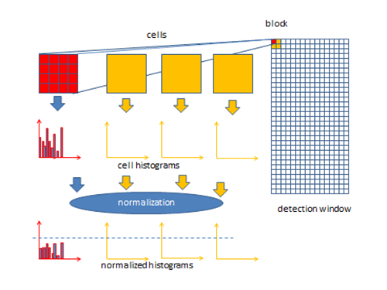

Slide 15
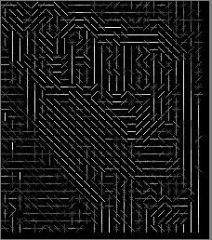
What the computer actually sees:

Slide 16
Implementation
In the design phase, we got an idea of how we can classify
2 classes only,
e.g. “A” vs no letter.
But what we do to classify N letters?
We do the same but many times!
The code snippet following explains this.

Slide 17
Results and Future Prospective
Outcome:
Fully working solution of the problem for the five first letters of the alphabet.
Statistics:
Gesture / Character | Success Rate in Prediction | Average Prediction Time
A | > 97 % | ~ 1 second
B | > 95% | ~ 1.5 seconds
C | > 95% | ~ 1 second
D | > 94% | ~ 1 second
E | > 92.5% | ~ 3 seconds
Future Updates and Possibilities:
Extend to all 26 letters,
Video Processing for Dynamic Gestures

Slide 18
Show Time!

